Slide 1

CARBON PRICING MECHANISM Case of UK and Germany
22nd March 2018
Collective Management Project

Slide 2

Agenda
Overview of Carbon policies
Case studies & Economical model
Impact of carbon pricing
Conclusion
Future perspectives
Mitigation
2

Slide 3
ETS and Carbon Price Floor
COMPARING CARBON PRICING MECHANISM IN BOTH COUNTRIES

Slide 4
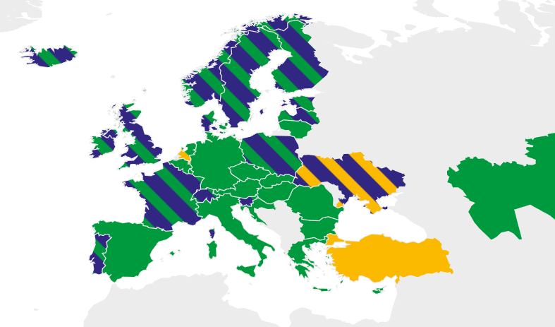
Carbon Pricing in Europe
There are 2 main types of carbon pricing:
Emission Trading System (ETS)
Cap total level of GHG emission across given sectors/ economy
Carbon Tax
Directly define a tax rate based on GHG emission
Supply & demand (market mechanism)
EU-ETS is the largest cap & trade market, covering ~2000 million tons emissions¹
ETS
Carbon tax
Under consideration
Source: World Bank, 2017
Notes:
¹ Source: World Bank, 2017

Slide 5
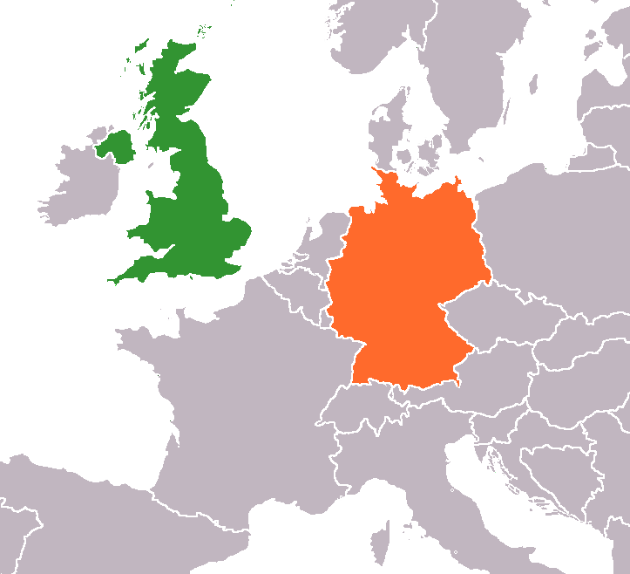
What about in the UK and Germany?
UK has hybrid pricing instrument to achieve ambitious GHG target in 2030 (<50% versus 1990 level)
Germany follows ETS scheme, which opens the market for allowance trading between companies
UK
Carbon Price Floor (CPF)
Comprising of carbon tax on top of EU ETS (hybrid)
EU
EU Emission Trading Scheme (ETS)
‘Cap and Trade’ principle
Introduced in 2013
1st phase was in 2005, ongoing 3rd phase (2013-2020)
Both instruments increase domestic wholesale electricity price differently (UK being higher)
Notes:
This covers the sectors not in the ETS – accounting for some 55% of total EU emissions – such as:
housing
agriculture
waste
transport (excluding aviation).
Source: https://ec.europa.eu/clima/policies/strategies/2020_en

Slide 6

Comparison of ETS vs. CPF
ETS
CPF
Germany
UK
European trading scheme
Carbon price floor
2020: -20% versus 1990 (EU Wide) | Overall rationale (GHG targets)⁴ | 2020: -35% versus 1990 (UK only)
2020: -20% versus 1990 (EU Wide) | Overall rationale (GHG targets)⁴ | 2020: -35% versus 1990 (UK only)
4.5 – 5.5 fluctuating¹ | Price (€/ ton CO₂) | EU ETS + CPS = CPF (£18) frozen value until 2020²
4.5 – 5.5 fluctuating¹ | Price (€/ ton CO₂) | EU ETS + CPS = CPF (£18) frozen value until 2020²
European Energy Exchange (EEX) Leipzig ICE Futures London | Where to transact | ETS same as EU Price difference (CPS) is paid to UK Treasury
European Energy Exchange (EEX) Leipzig ICE Futures London | Where to transact | ETS same as EU Price difference (CPS) is paid to UK Treasury
Slight increase (+ €4-6/ MWh) Emission levels remain stagnant | Impact of carbon pricing^{3.4} | Higher electricity price (+ €10-22.5/ MWh) 80% coal reduction by 2016
Slight increase (+ €4-6/ MWh) Emission levels remain stagnant | Impact of carbon pricing^{3.4} | Higher electricity price (+ €10-22.5/ MWh) 80% coal reduction by 2016
Source 1: UK House of Commons, 2018
Source 2: Intercontinental Exchange, 2018
Source 3: Ecofys, 2016
Source 4: Sandbag, 2015
Notes:
Source 1: UK House of Commons, 2018
Source 2: Intercontinental Exchange, 2018
Source 3: Ecofys, 2016 (The impact of a CO2 levy on the electricity sector)
Source 4: Sandbag, 2015 ( Carbon price instruments for the Power Sector )

Slide 7

Case Studies
DIFFERENT POWER GENERATION PORTFOLIO IN GERMANY AND UK

Slide 8





Power Plant Portfolios in Both Countries
Type (emission factor)
Germany
United Kingdom
100 MWe
200 MWe
(0.34 tCO₂/ MWth)¹
100 MWe
100 MWe
(0.25 tCO₂/ MWth)¹
20 MWe
20 MWe
Germany
UK
¹Source: IEA, 2015

Slide 9

Power Plant Technical Parameters
Parameters | CCGT | Coal | Renewable
UK O&M (€/MWh)¹ | 5.4 | 7.24 | 29.2
UK Fuel Cost (€/MWh_{th})² | 10.20 - 23.82 | 7.85 - 10.28 | -
Germany O&M (€/MWh)¹ | 6.27 | 9.52 | 25.4
Germany Fuel Cost (€/MWh_{th})² | 15 - 21.7 | 8.92 - 11.87 | -
UK (Nordpool Spot, 2017)
Day ahead market (DAM) price
Germany (EPEX Spot, 2017)
¹Power plant parameters: IEA, 2015; ²Fuel cost: Intercontinental Exchange.
Notes:
Why O&M cost higher in UK for Fossil?
Renewable cost in UK is higher due to the portion of wind power in UK is higher than in GER, also in this case, renewable in GER is using Solar, which obviously the O&M cost is lower.
Why using day ahead market?
Where do we get the picture

Slide 10
Renewables
HOW ARE THE PERFORMANCES OF RENEWABLE IN BOTH COUNTRIES?

Slide 11
PV Energy Profile (Germany)
Energy Generation : 24 GWh/y
Capacity Factor : 14%
Profit (FIT) : € 1.9 M
^{Source: NASA, 2017}
Notes:
FIT in Germany? Decreasing up to when? Until how much capacity for PV generation
FIT price is EUR/MWh 106.9

Slide 12
Wind Energy Profile (UK)
Energy Generation : 72.4 GWh/y
Capacity Factor : 41%
Profit (FIT) : € 0.45 M
^{Source: NASA, 2017}
Notes:
Where do you get
FIT in UK 40 (Jan-March), 37 ( Apr-Jun), 29 (Jul – Dec). Why FIT tariff in UK decrease? becau

Slide 13

ETS Impact in Germany

Slide 14
Model Assumption
Prices are known
Comparison between the STMC and the DAM price for the horizon of the year 2017
Temporal Resolution is up to hour ($24×365$intervals)
Multiple modes of operation : 100 % and 40 % Nominal Capacity
Cold Start-up time : 10h for coal and 4h for CCGT
$$STMC=\frac{Fuel Cost}{η}+CO_{2} cost+VOM+Startup Cost$$
Source: Flexibility in Thermal Power Plants, Agora 2017

Slide 15
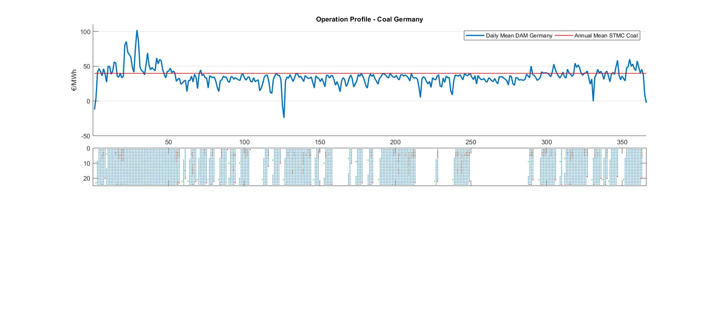
Germany Coal power plant

Slide 16
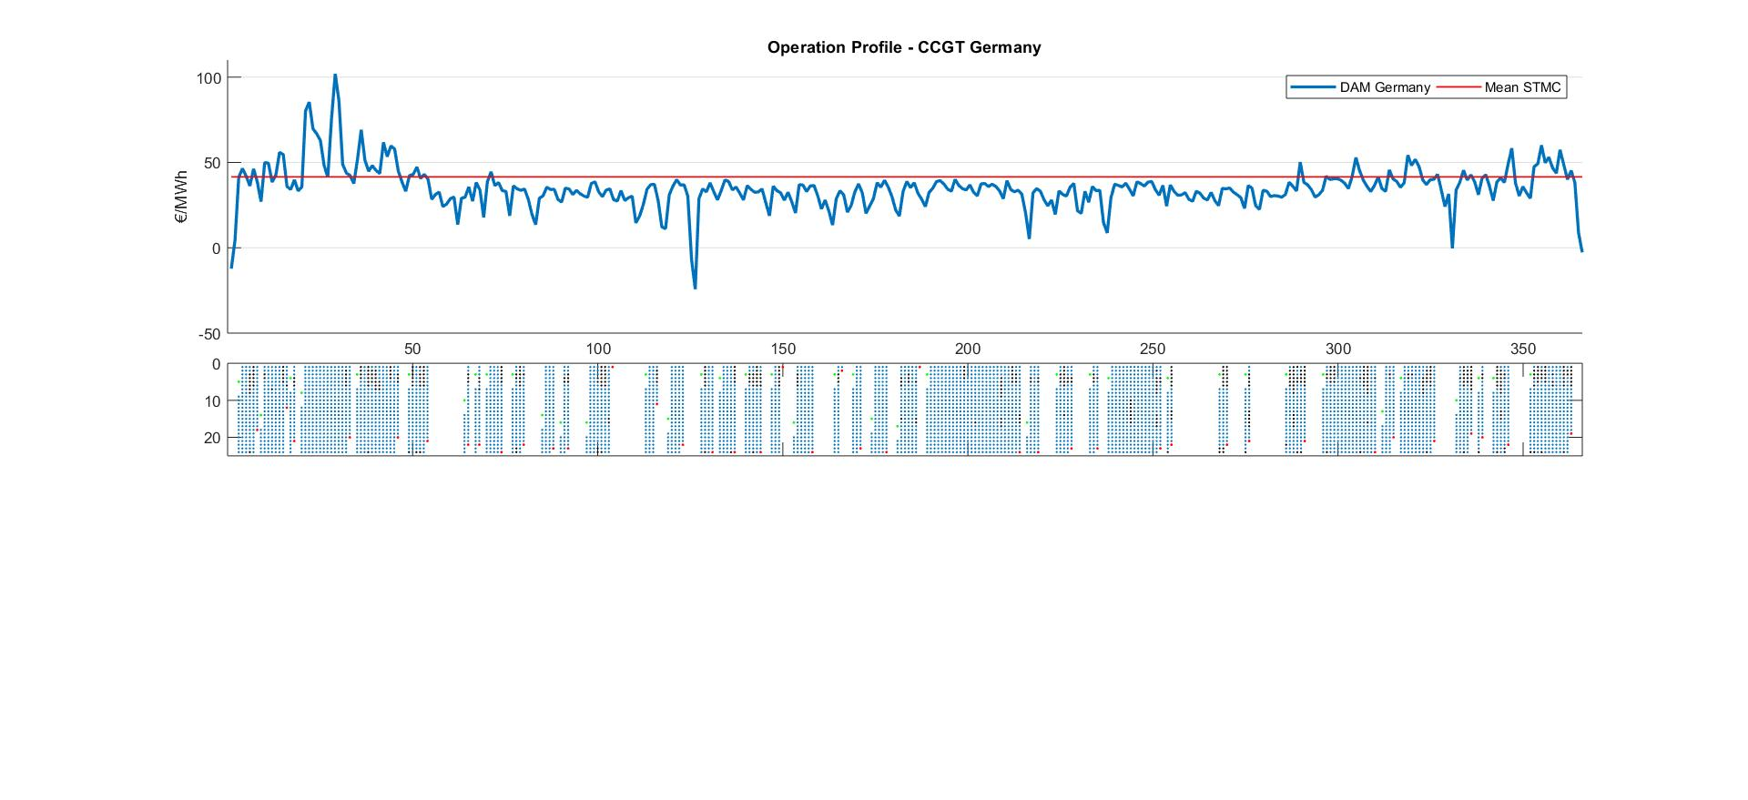
Germany CCGT power plant

Slide 17
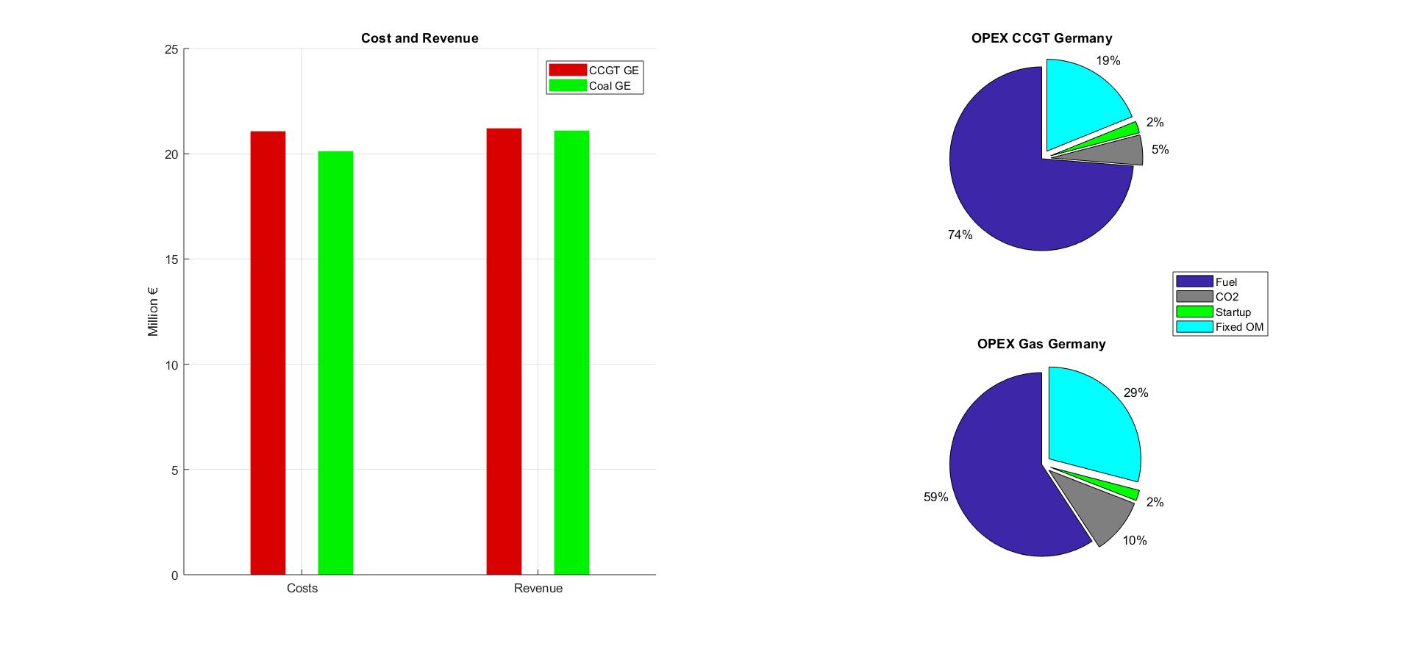
Germany: Profit & Cost
CCGT GE
CF : 61 %
Start-ups : 40
Annual Production : 0.51 TWh
STMC : 41.6 €/MWh
Profit: 0.16 mil € Margin: 0.308 €/ MWh
Coal GE
CF : 60 %
Start-ups : 28
Annual Production : 0.51 TWh
STMC: 39.8 €/MWh
Profit: 1.0 mil €
Margin: 1.96 €/ MWh
OPEX Coal Germany
Notes:
See that the CF for ccgt in Germany is not the nominal one, this is because coal now has pushed gas out of the merit and plays the role of the price setter

Slide 18
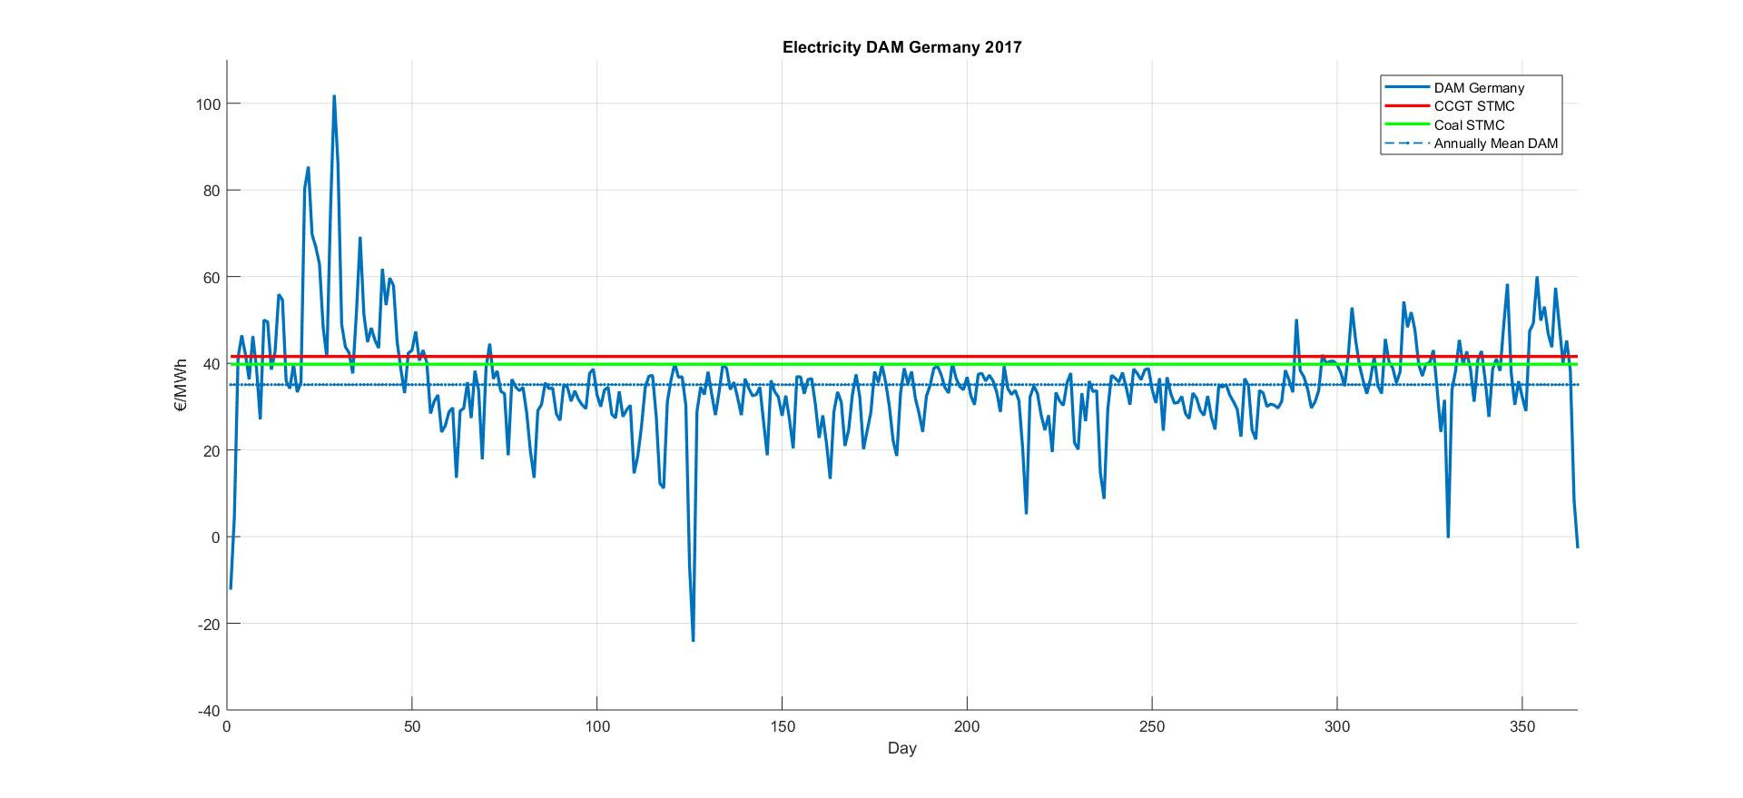
Germany: STMC vs DAM
Notes:
We see that the SMTC of CCGT is only slightly higher than coal in our model, this can be confirmed in the next slide, where production by coal is slightly higher than that of CCGT

Slide 19
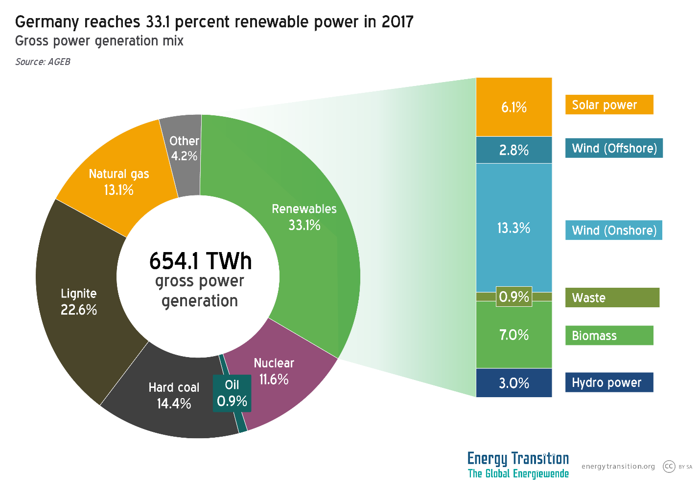
Germany Gross power generation mix
Notes:
Since coal now has replaced CCGT as the price setter.

Slide 20
Germany- Merit Order
Margin Price (€/MWh)
Capacity (GW)
RES
Nuclear
Lignite
Coal
Gas
Source: Fraunhofer Institute, 2017

Slide 21

CPF Impact in United Kingdom

Slide 22
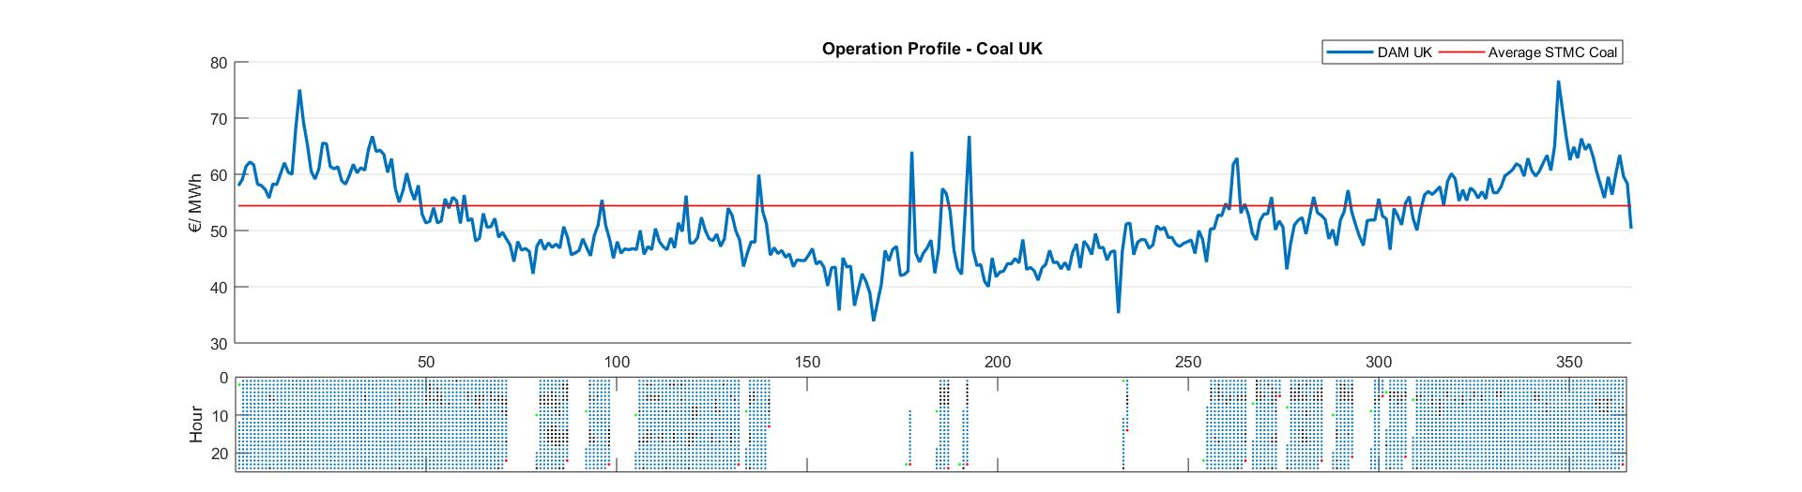
UK Coal
Notes:
Seasonal Variation

Slide 23
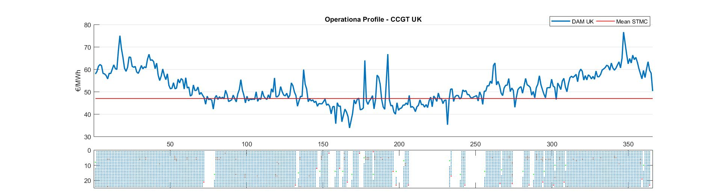
UK CCGT

Slide 24
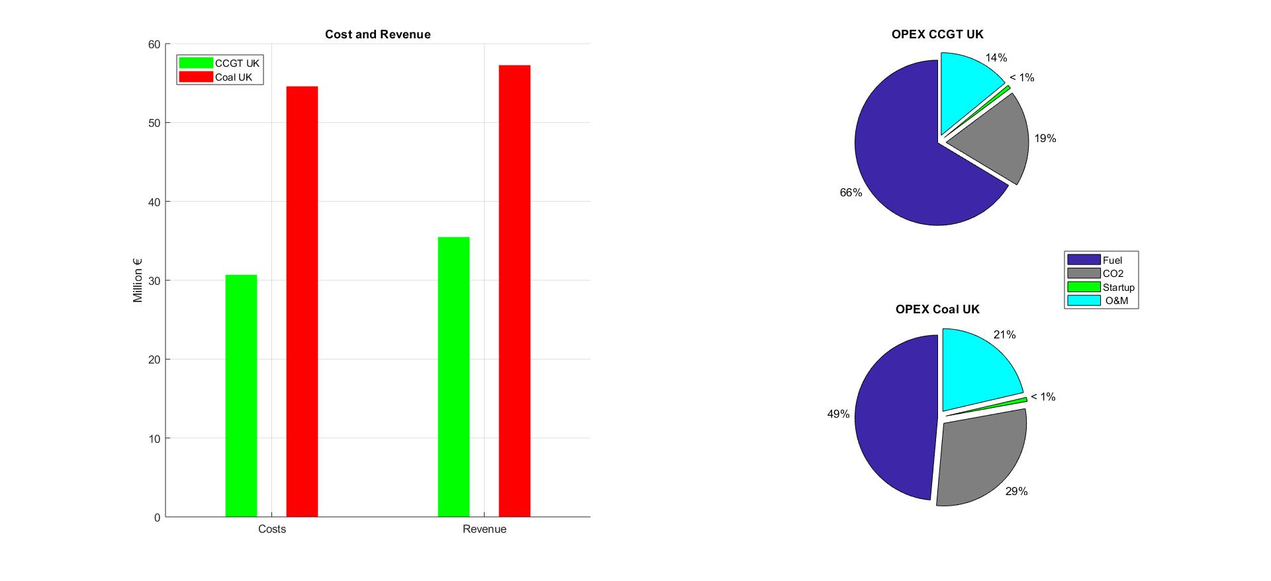
United Kingdom
CCGT UK
CF : 75 %
Start-ups : 21
Annual Production : 0.65 TWh
STMC: 47 €/MWh
Profit: 4.8 mil €
Margin: 7.35 €/ MWh
Coal UK
CF : 60 %
Start-ups : 16
Annual Production : 1.0 TWh
STMC : 54.4 €/MWh
Profit: 2.7 mil €
Margin: 2.66 €/ MWh
Notes:
Since the capacity of coal generator in the UK is 200 MW, the generation is almost twice the size that of CCGT, but its revenue is ½ that of CCGT.

Slide 25
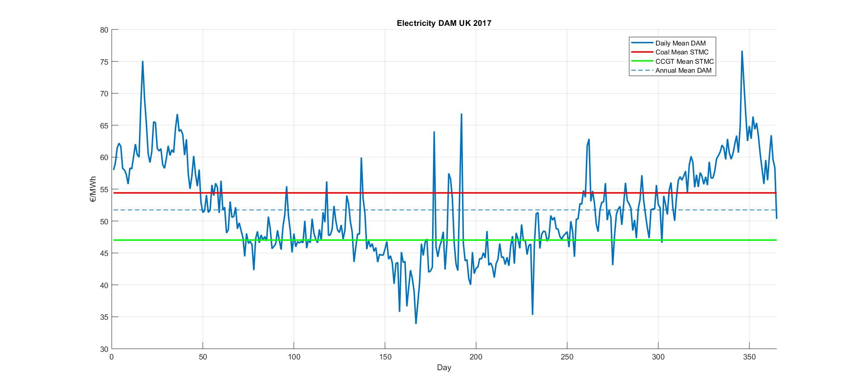
United Kingdom
Notes:
Clear differerence between STMC for coal and gas
Gas : operating in base-load mode
Coal : out of merit

Slide 26
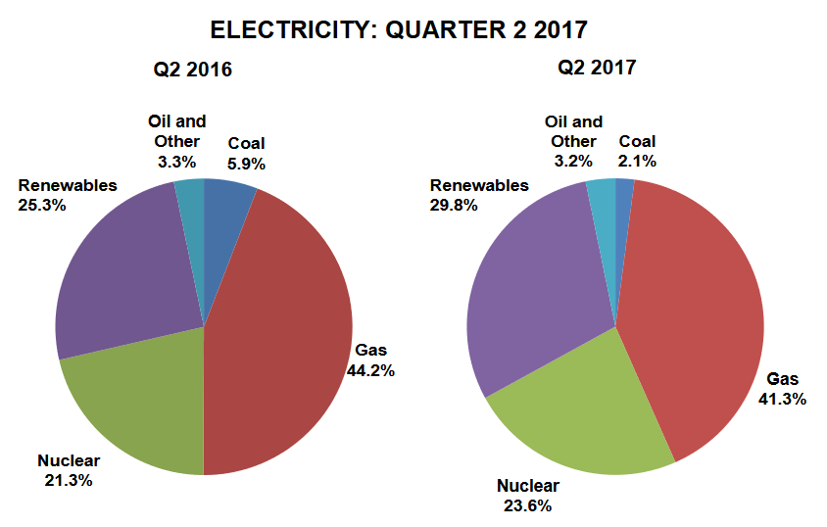
Source : DBIES, 2017
Notes:
Coal Production Share dropped more than 60% as compared to 2016
Gas stayed the same
This shows that the UK is right on the schedule for the retirement of the remaining coal generators by 2025.

Slide 27
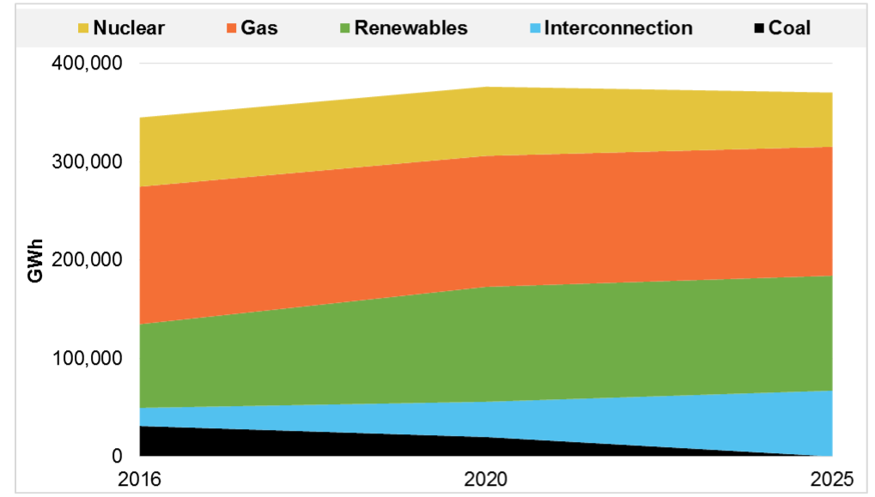
The Retirement of Coal in the UK !
IEEFA 2017, Electricity – Grid Transition in the UK
Notes:
The remaining 14 GW of coal will be retired by 2025

Slide 28
Merit Order – United Kingdom
Margin Price (€/MWh)
Capacity (GW)
RES
Nuclear
Lignite
Gas
Coal
Source: OFMEG, 2016

Slide 29

Overall Economic Result
SUMMARY OF ECONOMIC CALCULATION

Slide 30
Overall Economical Results - Germany
Germany | Energy (GWh) | Profit (Million EUR)
PV | 24 | 1.94
CCGT | 510 | 0.16
Coal | 510 | 1
Notes:
Coal and CCGT account for more than 95% of production
Surprisingly, PV actually generates more than 2/3 of the profit. Then Coal and then CCGT

Slide 31
Overall Economical Results - UK
UK | Energy (GWh) | Profit (Million EUR)
Wind | 72.4 | 0.44
CCGT | 650 | 4.8
Coal | 1,000 | 2.7

Slide 32

Sensitivity Analysis
WHAT IF THE CARBON PRICE CHANGES?

Slide 33
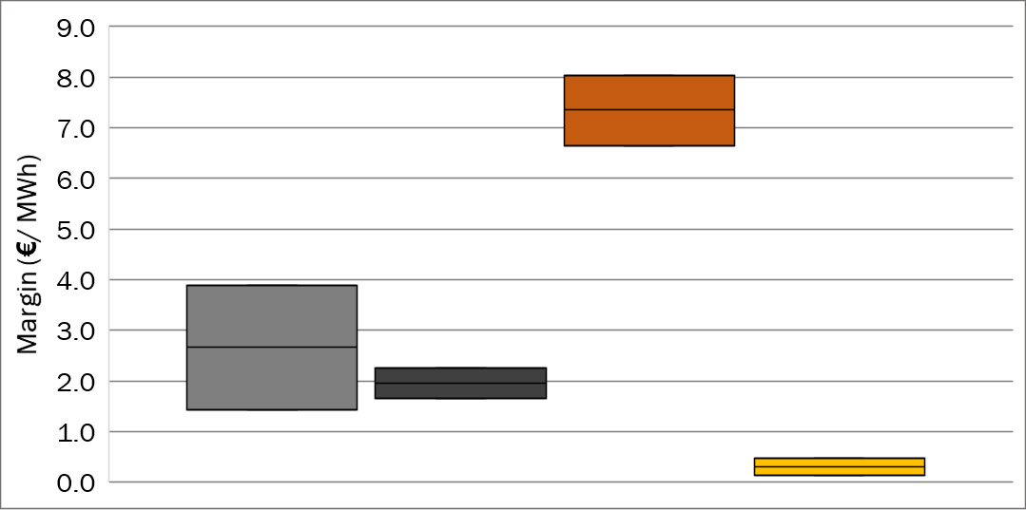
Margin due to Carbon Price Changes
Low case
Base case
High case
Coal UK
Coal Germany
CCGT UK
CCGT Germany
Margin variation if higher CO₂ price (+8%) or lower CO₂price (-8%) is implemented
Margin = Marginal Profit for each MWh generated
Notes:
Explain the base cases
Explain the indicator (margin)
2 observations :
Higher bar $→$ Higher Profit
Wider bar $→$ More exposed to risk
Results by countries :
GE : low exposure $→$ due to low ETS. But also low profit $→$ low DAM
UK : high profit but also highly exposed $→$ due to high CP + high DAM

Slide 34
Supply Merit Order
Germany
UK
Margin Price (€/MWh)
Margin Price (€/MWh)
RES
Nuclear
Lignite
Coal
Gas
RES
Nuclear
Lignite
Gas
Coal
Carbon Price Floor!
Source: Fraunhofer Institute, 2017; OFMEG, 2016
Notes:
In Germany, coal is still on the left
In the UK, gas replaces coal due to high DAM and CP

Slide 35

Conclusion
AND FUTURE OUTLOOK OF CARBON PRICING MECHANISMS

Slide 36
Recap of the Project
Coal power plants are the most affected by the Carbon Price Policies
The UK's carbon price floor policy has accelerated the phase-out of the coal plants
CCGT plants in Germany are being shut down due to expensive short term marginal cost
1
2
3

Slide 37

Future Perspectives
WHAT WOULD BE THE TRENDS?

Slide 38
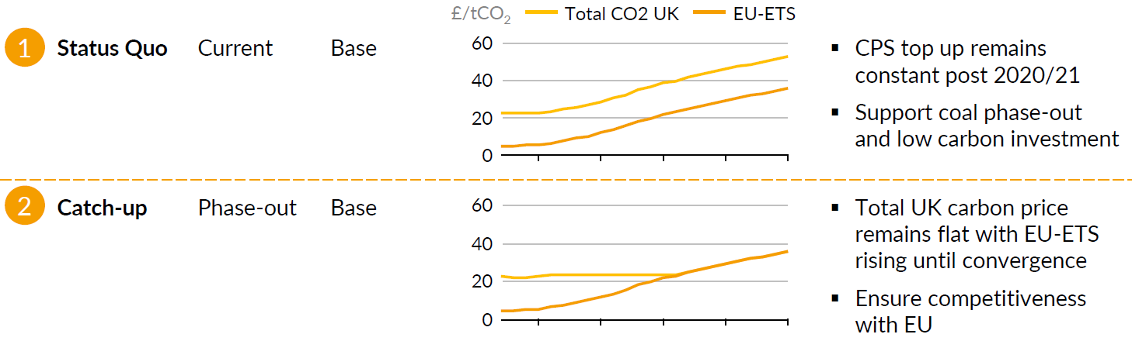
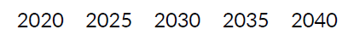
Two Plausible Scenarios - Post 2020
CPF
ETS
Carbon Price Trajectory
CPF
EU ETS
Source: Aurora Energy Research, 2017

Slide 39

Mitigation
HOW SHOULD OUR COMPANIES REACT TO CARBON POLICIES?

Slide 40
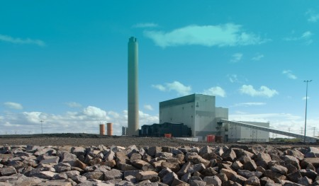
Proposed Strategies
Increasing ETS and assumed constant fuel cost
Shut down coal
Clean coal technology: reasoning (CCGT is going to benefit from higher ETS, thus coal becomes more vulnerable to higher ETS)
Convert into biomass plant, like the trend in UK
Houghton wins contract at UK coal-to-biomass conversion at Lynemouth power station (2017)
Source: Power Engineering International, 2017
Notes:
1st scenario : increasing ETS and assumed constant fuel cost
Shut down
Cleaning coal : reasoning (CCGT is going to benefit from higher ETS, so the only thing that is vulnarable to higher ETS, higher ETS also increases the CO2 emission and the motivation for phasing out coal)
Convert into biomass
2nd scenario : CFP in the EU
Shut down only becaue R&D takes a lot of time, which is not possible with the introduction of CFP
Depending on the introduction of the CFP, we would have to decide to transform into cleaner coal or biomass ASAP.

Slide 41
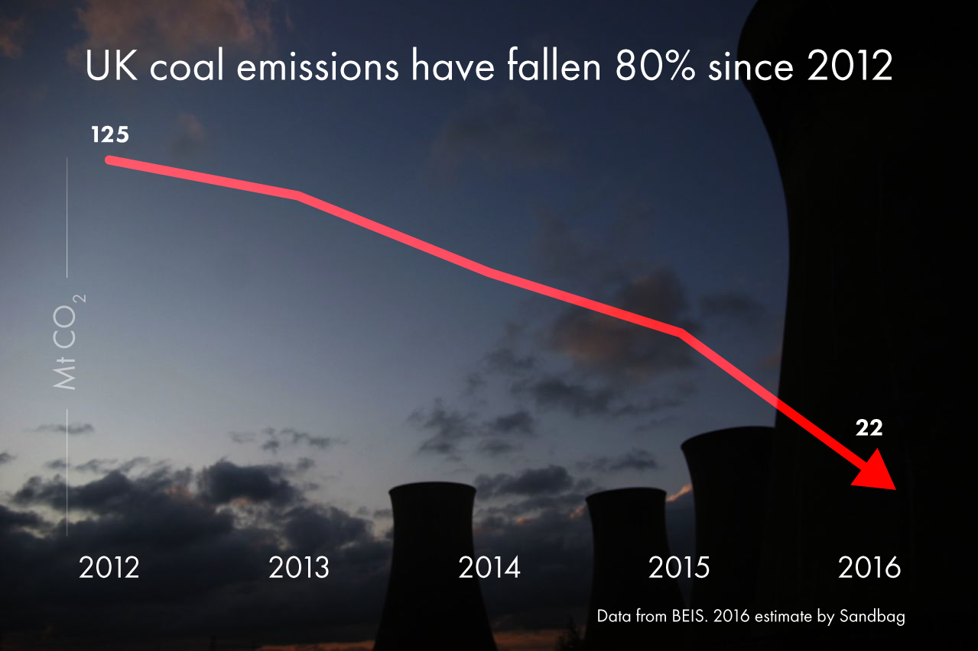
CPF in the EU (Germany) - *low probability
The introduction of CPF is done in a short period of time
The introduction of CPF is done gradually, it would allow to do a project study to decide
Option A
Shut down only, because R&D requires long time
Option B
Depending on the introduction of the CPF, it depends whether to transform into cleaner coal or biomass as soon as possible
Source: Sandbag, 2016

Slide 42
Thank You
“There is no planet B.”
United Nations Sustainable Development
Q&A Session

Slide 43

Annex
IMPORTANT DATA AND CALCULATIONS

Slide 44
Germany :
-CCGT generates higher short term marginal costs of generation than Coal.
-The % of Fuel cost in CCGT Operation expenditures is higher than the one of Coal power plant.
-Carbon price influences more the OPEX in Coal power plants than in Gas power plants, because Coal is more polluting than gas, it has higher emission factor.
-Renewable installations have close to zero marginal costs, therefore they lower the entrance price and push more expensive conventional producers down the ’merit order’.
-Gas-fired and coal power plants: represent high generation costs (often owned by the large utilities or municipal utilities) and are vulnerable to being pushed out of the market as they cannot compete at the lower prices.
UK:
-CCGT generates lower short term marginal cost compared to Coal power plants
-Gas turbine power plants are more profitable than coal power plants in UK, they generate high net profit
-Coal capacity in the UK (200Mw) is twice the CCGT capacity (100Mw), however the net profit from coal is half the one from CCGT, this is due to the fact that Coal power plants are very polluting and that the UK holds a floor price which is not flexible , ensuring a continuous high carbon pricing mechanism ————> Coal is not profitable in UK , CCGT is by far more convenient and profitable
-For coal power plants in UK , Co2 allowances accounts fro approximately 29% compared to CCGT in which it represents only 19%
-Coal is getting completely pushed away from the market by CCGT in UK
-This fact is confirmed by the chart of electricity resources distribution in Uk in which the amount of electricity production by coal has decreased from 5.9% in 2016 to 2.1% in 2017.

Slide 45
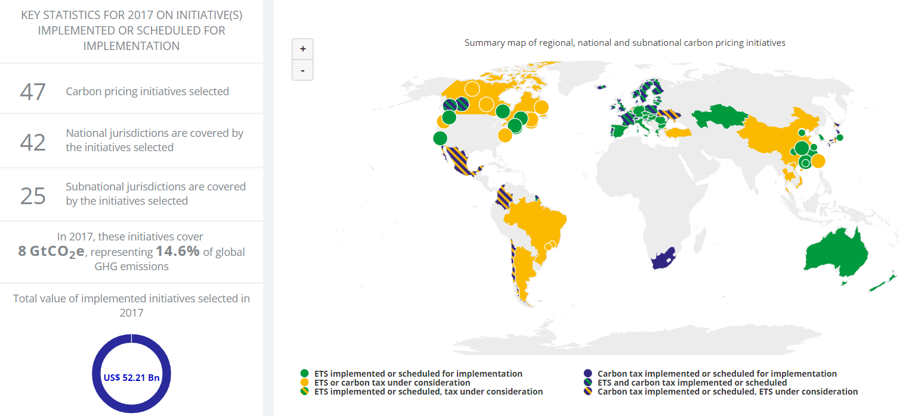
Carbon Pricing Map (World Bank, 2017)

Slide 46
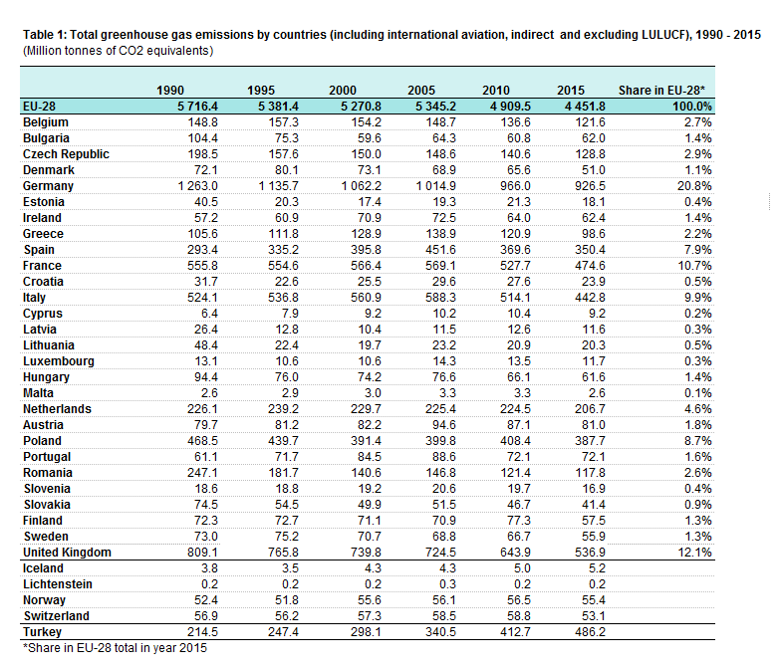
EU Emission Level (Country Comparison)

Slide 47
Carbon Market in The World (World Bank, 2017)
Jurisdiction | % MMT Covered | Country’s MMT CO₂e | MMT Covered by Price | Year Implemented
China | 50 | 10,563 | 5,282 | 2016
EU ETS | 45 | 3,967 | 1,785 | 2005
Japan | 70 | 1,170 | 819 | 2012
Mexico | 40 | 700 | 280 | 2014
South Korea | 60 | 655 | 393 | 2015
Australia | 60 | 600 | 360 | 2012
United Kingdom | 40 | 543 | 217 | 2001
California, USA | 35 | 497 | 174 | 2012
France | 35 | 487 | 170 | 2005
South Africa | 80 | 457 | 366 | 2016
Kazakhstan | 50 | 303 | 151 | 2013
Alberta, Canada | 50 | 249 | 125 | 2007
Chile | 40 | 101 | 40 | 2017
Beijing, China | 50 | 100 | 50 | 2013
Quebec, Canada | 30 | 88 | 26 | 2013
Finland | 15 | 76 | 11 | 1990
New Zealand | 50 | 71 | 36 | 2008
British Columbia, Canada | 70 | 61 | 43 | 2008
Sweden | 25 | 60 | 15 | 1991
Ireland | 40 | 57 | 23 | 2005
Denmark | 45 | 54 | 24 | 1992
Norway | 50 | 50 | 25 | 1991
Switzerland | 30 | 50 | 15 | 2008
Costa Rica | 85 | 15 | 13 | 1997
Iceland | 50 | 3 | 1 | 2005

Slide 48
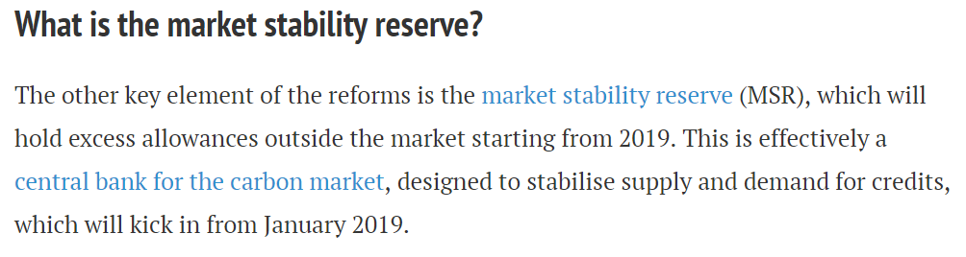
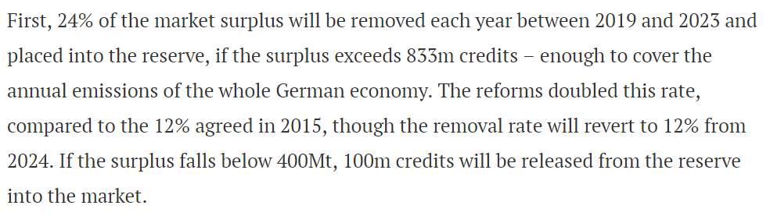
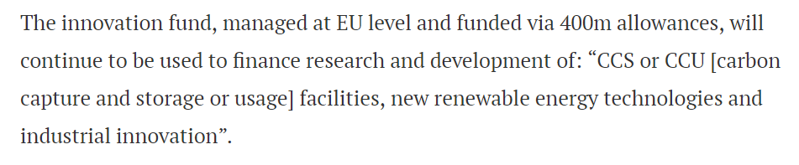
MSR to Stabilize Supply and Demand
https://www.carbonbrief.org/qa-will-reformed-eu-emissions-trading-system-raise-carbon-prices

Slide 49
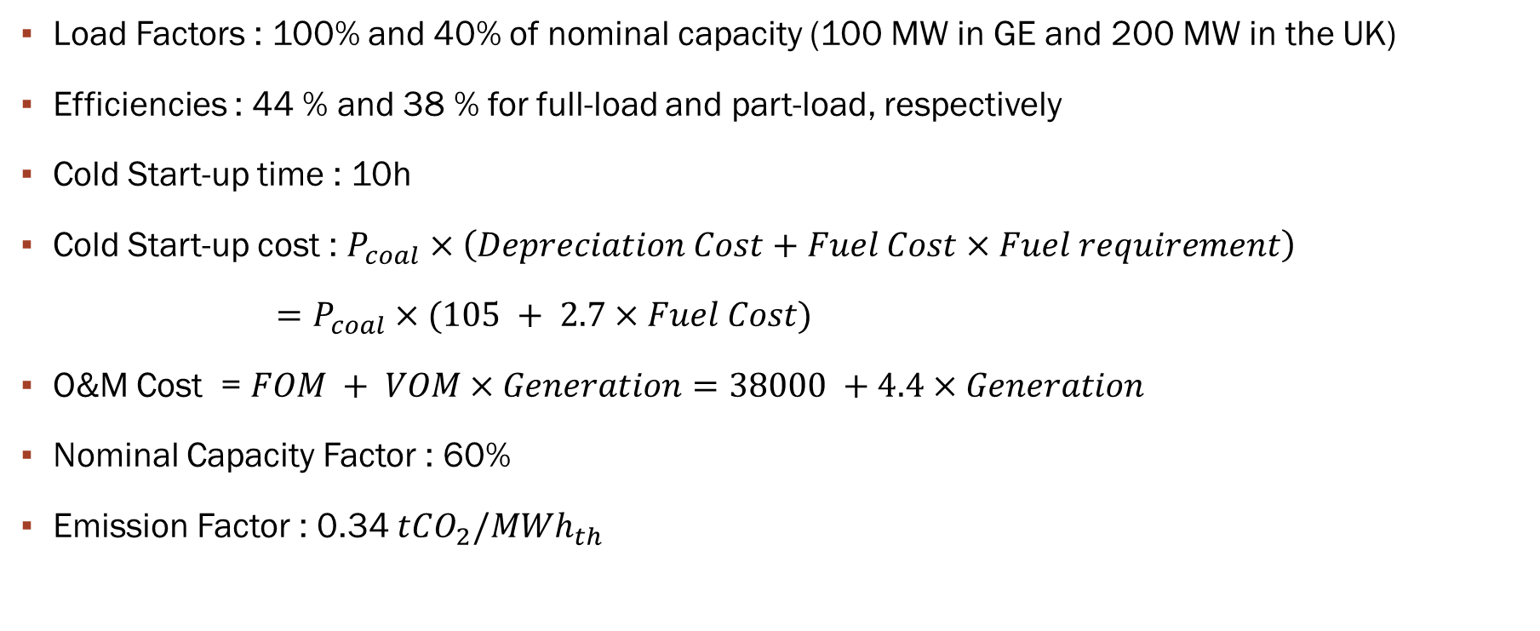
Input Parameters - Coal
Load Factors : 100% and 40% of nominal capacity (100 MW in GE and 200 MW in the UK)
Efficiencies : 44 % and 38 % for full-load and part-load, respectively
Cold Start-up time : 10h
Cold Start-up cost : $P_{coal}×\left(Depreciation Cost+Fuel Cost×Fuel requirement\right)$
$=P_{coal}×(105 + 2.7×Fuel Cost)$
O&M Cost = $FOM + VOM×Generation=38000 +4.4×Generation$
Nominal Capacity Factor : 60%
Emission Factor : 0.34 $tCO_{2}/MWh_{th}$

Slide 50

Input Parameters - CCGT
Load Factors : 100% and 40% of nominal capacity (100 MW in GE and 100 MW in the UK)
Efficiencies : 58 % and 47 % for full-load and part-load, respectively
Cold Start-up time : 4h
Cold Start-up cost : $P_{coal}×\left(Depreciation Cost+Fuel Cost×Fuel requirement\right)$
$=P_{coal}×(105 + 2.7×Fuel Cost)$
O&M Cost = $FOM + VOM×Generation=28000 +2.3×Generation$
Nominal Capacity Factor : 75%
Emission Factor : 0.25 $tCO_{2}/MWh_{th}$

Slide 51
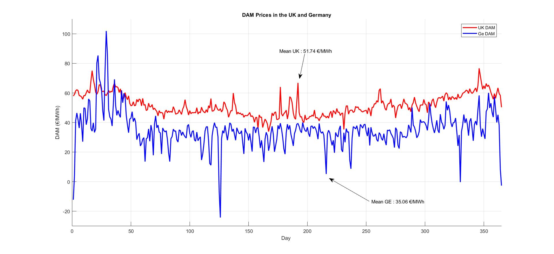
Notes:
We can see that the price in Germany is more flattened out due to the high penetration of renewables

Slide 52
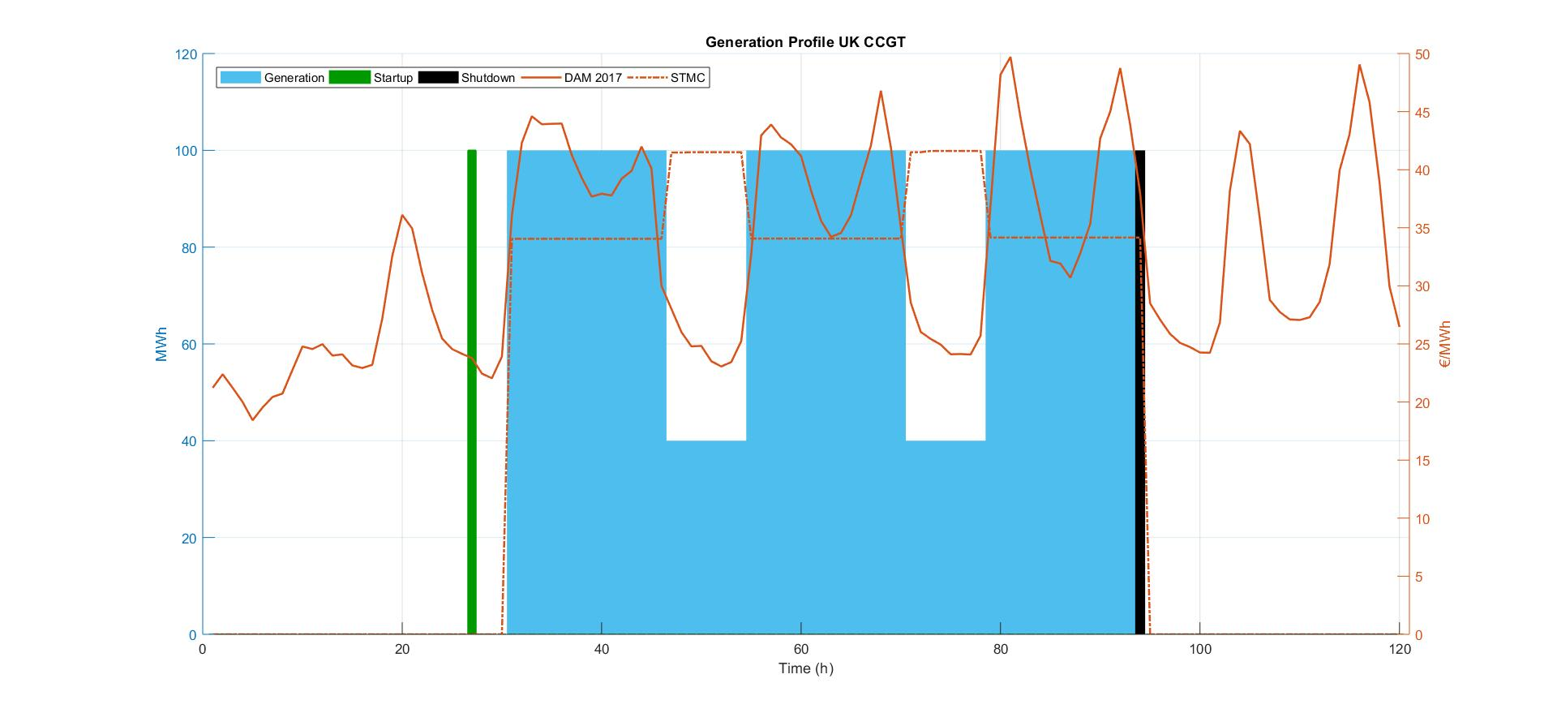
Model Demonstration

Slide 53
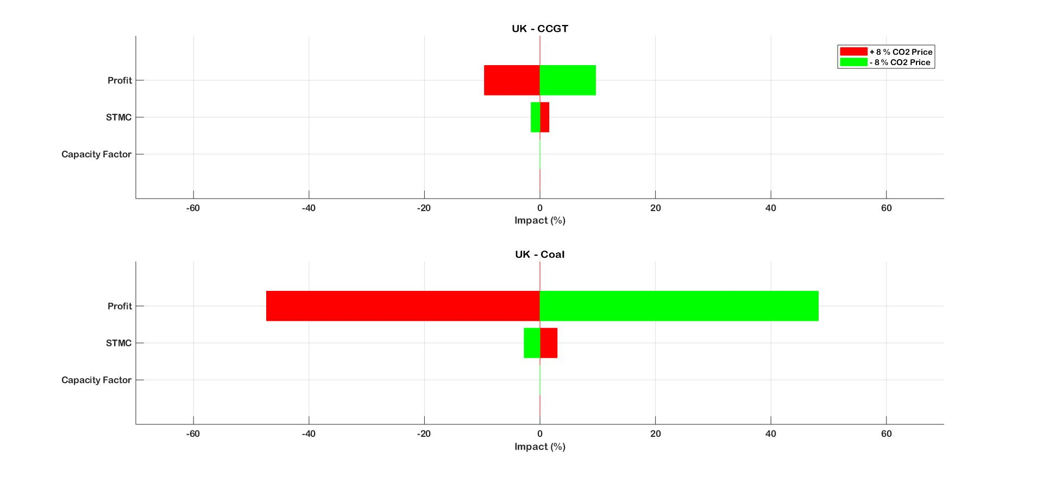

Slide 54
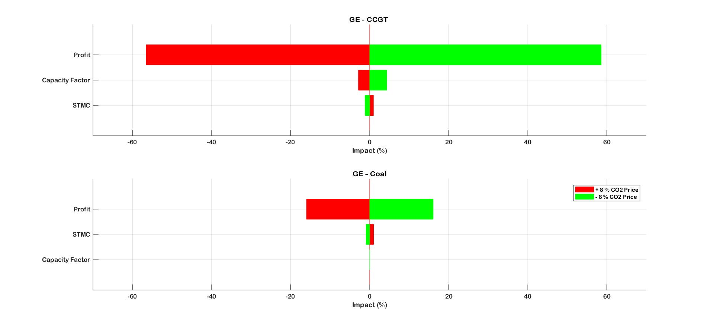

Slide 55
Overall Results

